Slide 1
UCHC-AAUP
Chapter Meeting
May 17, 2016
5:00 – 7:30 PM
Patterson Auditorium

Slide 2
UCHC-AAUP Agenda
Leadership Report (Laks, Joe, Ann)
Recent happenings, current negotiation & election
Executive Director’s Report (Dio)
Recent Accomplishments
Membership and Outreach

Slide 3
Leadership Report
Recent Happenings
ABP Issue
Current CBA negotiation
Upcoming Election

Slide 4
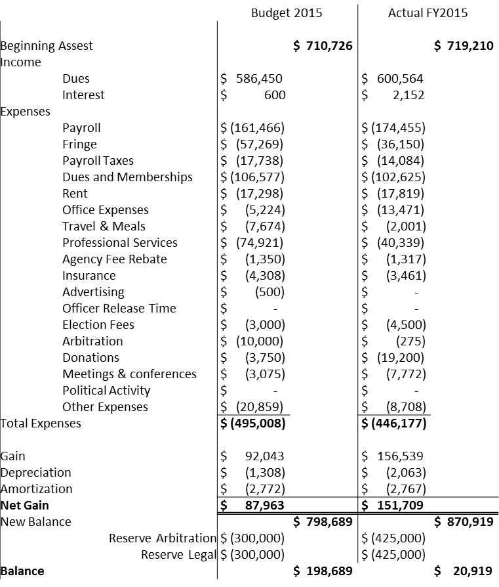
FY2015 FINANCIAL STATEMENT

Slide 5
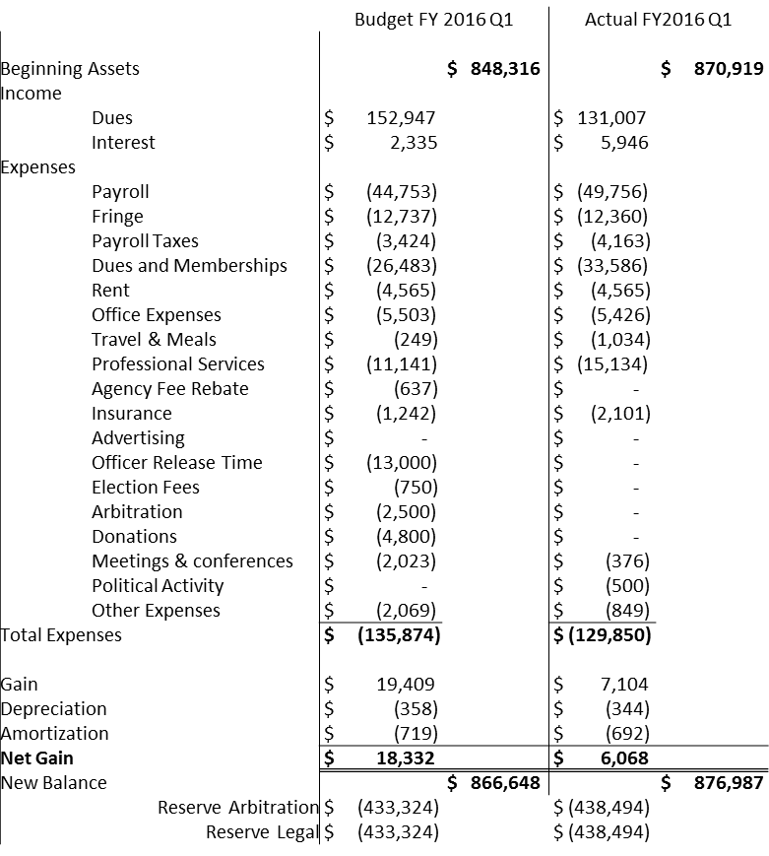
FY2016 Q1 FINANCIAL STATEMENT

Slide 6
E.D. Report Dio
Recent Accomplishments
Membership and Outreach

Slide 7
Your thoughts?
Questions?

